Slide 1

AsRaymond
Date:- 04/30/25

Slide 2

1
2
3
4
5
6
Team Introductions & Project Scope
Company Overview
Nexus Collection
Forecasted Project Plan Overview
Next Steps
Questions
© Avalara. Confidential and proprietary.

Slide 3

Team Introductions & Project Scope
  Avalara:
    Ankush: AvaTax Consultant
    Jagdeep: Project Manager
  Customer Name:
    Dan Tuller: Title
    XXXX: Title
  Project Scope:
    AvaTax Implementation with Infor M3 with API
  Statement of Work Expiration: 04/14/26
  Environments:
    Sandbox (2007295587): http://sandbox.admin.avalara.com – 07/13/2026
    Production (2006488282): https://admin.avalara.com

Slide 4
Company Overview
  Implementation Q&A:
    Are you an existing or net new client to AvaTax? New Client
    What Items/Services are Sold? Not Provided
    Infor M3:
      Live?
      Sandbox Available?
    Time Zone? EST
    Target Go Live? Ist Sept.
  Implementation Questionnaire:
    Any issues or concerns in filling out/submitting?
  Company Information:
    Legal company name: Barnes Group Inc.
    Primary company address: 370 W. Dussel Drive Suite A, Maumee, Ohio, 43537 (United States)
    How many filing entities? None
    Company structure?
    Do you have multiple physical locations (i.e., brick and mortar stores, warehouse, etc)? No
    FEIN? 06-0xxxxxx
Notes:
ECM - Confirm product purchased if conflicting info on SOW and questionnaire, discuss gathering customer data/certificates if not provided via questionnaire, and talk through ECM (w/wo MS) go live plan.

Slide 5
Nexus Collection
WA
ME
What US states and CAN provinces are you currently registered to collect Sales and Use tax? Local Jurisdictions?
Effective date?
What US states and CAN provinces are you planning to get registered in? Local Jurisdictions?
MT
ND
OR
MN
SD
WI
NY
ID
MI
WY
IA
PA
NV
NE
IL
IN
OH
UT
CO
WV
VA
CA
KS
MO
KY
TN
NC
AZ
NM
OK
AR
SC
MS
AL
GA
TX
LA
AK
FL
Notes:
If client is unsure of what their registration effective date is, then we should default to the beginning of the year (Jan 1st) for any states currently registered in. If the client is in progress with registrations, the “start date” on the registration's questionnaire should be used.
What if the client doesn’t know where they need to get registered? Push to reach out to their third-party tax advisor if they have one or let them know about Avalara services that are available to help (i.e., PSTRA/STRA).
Client can use Avalara to register in states through Avalara State Registrations. Registering via Avalara – It is the customer’s responsibility to complete the questionnaire and reach out to the registration team directly for questions at RegistrationSupport@avalara.com.

Slide 6
Forecasted Project Plan Overview
Phases | Forecasted Dates | Key Milestones
Planning/Execution | 30 April, 2025- 02 May, 2025 | Kickoff Call (Avalara/Client) Technical Discovery Call (Avalara/Client) AvaTax Setup (Avalara) AvaTax Training & Configuration Call (Avalara/Client) Item Taxability Review Call (Avalara/Client) Connector Configuration Call (Avalara/Client)
Testing | 02 May, 2025- 02 June, 2025 | Create a Plan for Testing. (Client) Perform Unit /UAT Testing. (Client) Issue Resolution (Avalara/Client) Production Sign Off (Client) AvaTax Migration to Production (Avalara) Connector Configuration in Production. (Client)
Go Live | 02 June, 2025- 13 June, 2025 | Go Live (Client) Post-Production Support (10 – Business Days) (Avalara)
Notes:
If they don’t feel out the questionnaire the client doesn’t have to go back and fill it out. We can just use the information gathered on the KOC to fill out the Google Drive docs.

Slide 7
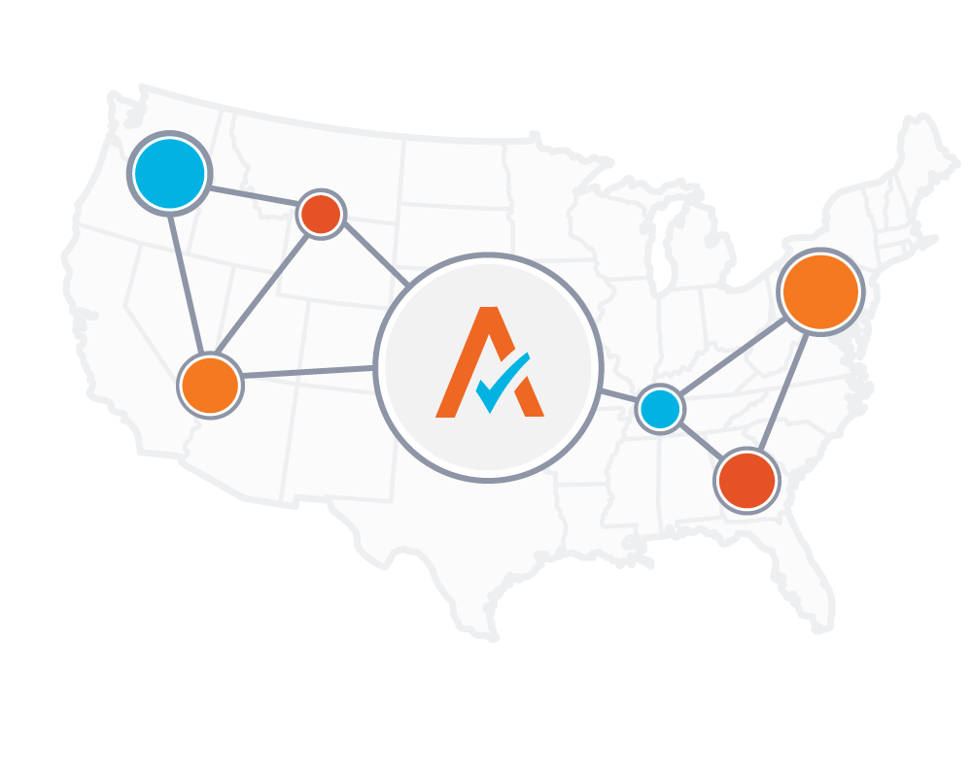
Next Steps
  1) Schedule AvaTax Training & Configuration Call (Ankush)
    Include AvaTax Admin(s), and Tax Specialists/Software Users
    Please complete a test login to your AvaTax Sandbox prior to call http://sandbox.admin.avalara.com/
    User with access: dtuller@onebarnes.com
  2) Schedule Bi-weekly Status Calls. (Jagdeep)
    Review project timeline and open tasks
    Troubleshoot
    Discuss questions and concerns

Slide 8

Questions?

Slide 9



Tax Code Selection - Steps To Take
Identify if your products/services are Taxable/non-taxable
Identify if they deviate from default taxable (TPP-default setting in Avalara)
If they deviate from default taxable- select applicable Avalara codes from: https://taxcode.avatax.avalara.com/ to match your products &services
Send tax codes per Unit/Group to Avalara Team or login and go to tab ‘taxability matrix’
Avalara team will generate a taxability matrix that shows the behavior of the AvaTax system which these codes
Taxability Review call
Set up final mapping in AvaTax or ERP

Slide 10

Helpful Links
Avalara Knowledge Center
AvaTax Sandbox
Avalara Tax Code Search Tool
Statement of Work
Avalara University
Connector information
About SST returns
Where do I have Nexus

